Slide 1
Array Lists
7.7

Slide 2
Array Lists
An array list acts much like an array with a few exceptions.
It is actually an object, so it has methods which can be called
Its size is variable and can change as necessary
Array lists have size, not length. size( )
Only stores objects
To access an element you use the get(i) method
The add( someObject ) method adds an object to the end of the list.

Slide 3
Array Lists
set(i, object) will change what is stored at index i to whatever object is passed
remove(i) will remove the object at index i and will adjust the size of the array

Slide 4
Syntax
ArrayList<type> variable = new ArrayList<type>();
ArrayList<String> names = new ArrayList<String>();
ArrayList<Dice> dice = new ArrayList<Dice>();
ArrayList<int> values = new ArrayList<int>();
ArrayList<double> values = new ArrayList<double>();
The highlighted ones are incorrect

Slide 5
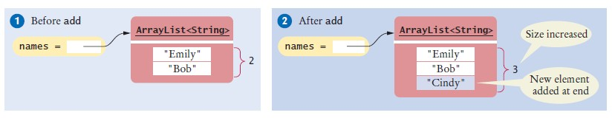
ArrayList<String> names = new ArrayList<String>();
names.add("Emily"); // Now names has size 1 and element "Emily" names.add("Bob"); // Now names has size 2 and elements "Emily", "Bob" names.add("Cindy"); // names has size 3 and elements "Emily", "Bob", and "Cindy"

Slide 6
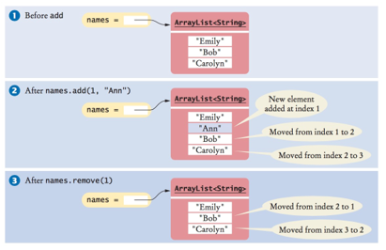
Examples

Slide 7
Homework
Download the file GettysburgAddress.txt from the website. You are going to use a scanner to read each work of the Gettysburg address and add each word to an arraylist of Strings. The program should then identify the longest word in the address, as well as the average word length.
Scanner file = new Scanner(new File(filename));
// assume filename stores the name of the file
while (file.hasNext())
{
word = file.next();
}

